Slide 1
C Strings
A C string is a variable-length array of characters that is delimited by the null character.
A string is a sequence of characters.
A string literal is enclosed in double quotes.

Slide 2
DECLARING AND INITIALIZING STRING VARIABLES
Declaring a String:
A string variable is a valid C variable name and always declared as an array.
The general form of declaration of a string variable is,
char string_name [size];
The size determines the number of characters in the string_name.
When the compiler assigns a character string to a character array, it automatically supplies a null character(‘\0’) at the end of the string.
The size should be equal to the maximum number of characters in the string plus one.

Slide 3
DECLARING AND INITIALIZING STRING VARIABLES
Initializing a String: This can be done in two ways.
1. char str1[7]=“Welcome”;
2. char str2[8]={‘W’,’e’,’l’,’c’,’o’,’m’,’e’,’\0’};

Slide 4
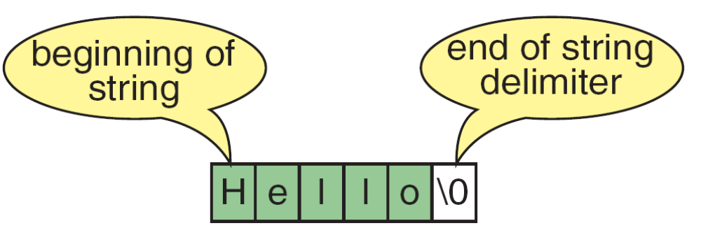
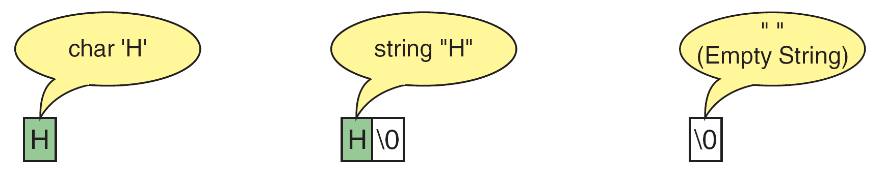
Storing Strings and Characters

Slide 5
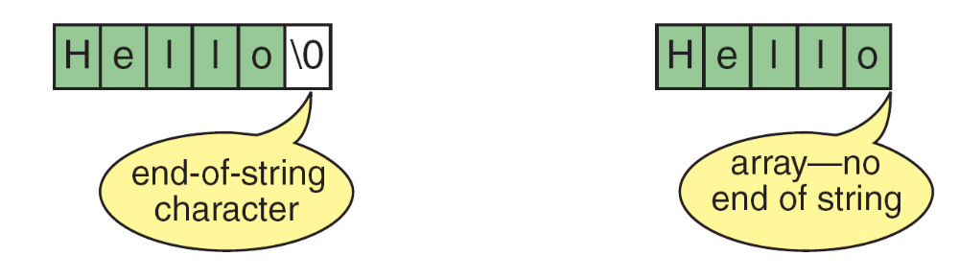
Differences Between Strings and Character Arrays

Slide 6
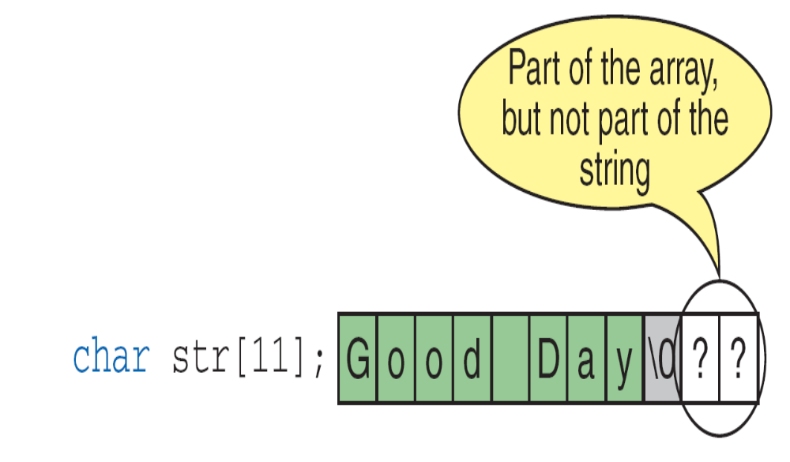
Strings in Arrays

Slide 7
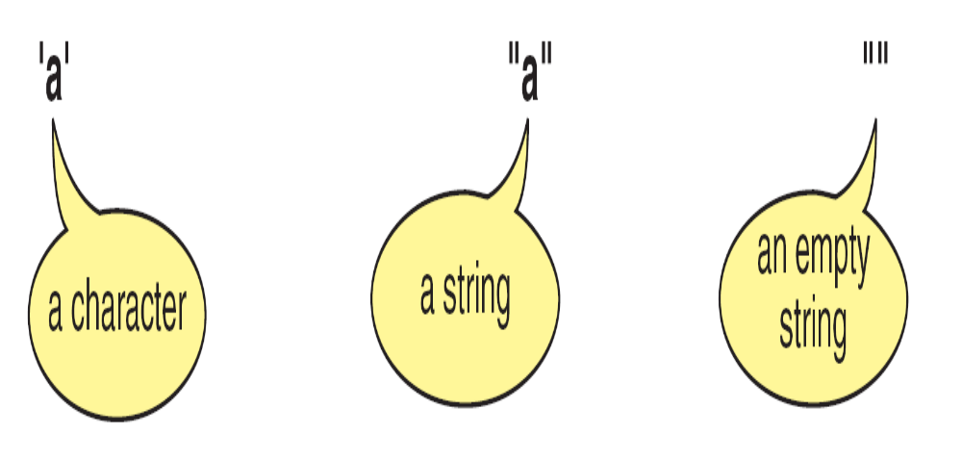
Character Literals and String Literals

Slide 8
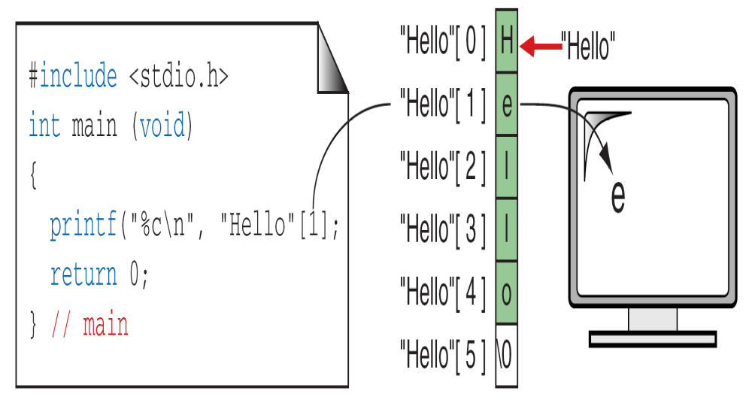
String Literal References

Slide 9
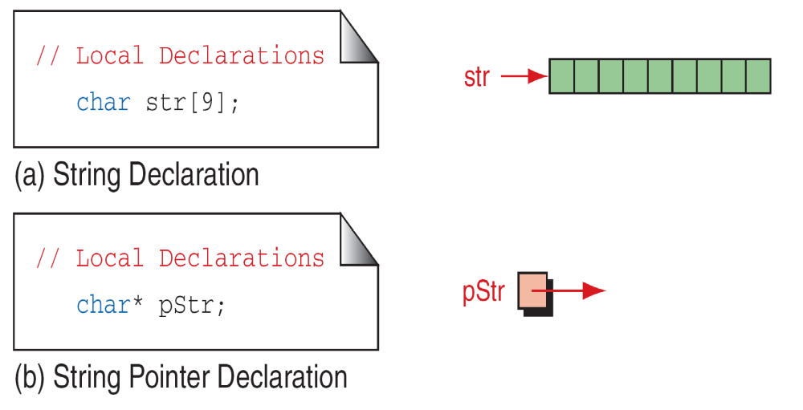
Memory for strings must be allocated before the
string can be used.
Defining Strings

Slide 10
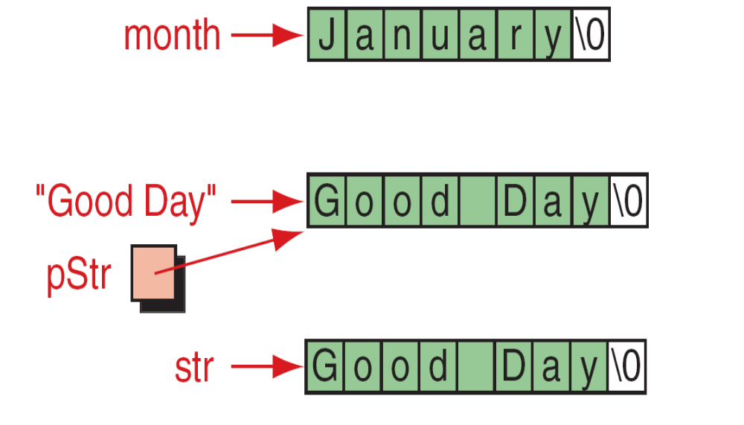
Initializing Strings

Slide 11
String Input/Output Functions
C provides two basic ways to read and write strings.
First, we can read and write strings with the formatted input/output functions, scanf/fscanf and printf/fprintf.
Second, we can use a special set of string-only functions, get string (gets/fgets) and put string ( puts/fputs ).

Slide 12
STRING INPUT/OUTPUT FUNCTIONS(Contd…)
Formatted input and output functions: scanf () and printf()
The string can be read using the scanf function with the format specifier %s.
Syntax for reading string using scanf function is
scanf(“%s”, string_name);
Disadvantages:
The termination of reading of data through scanf function occurs, after finding first white space through keyboard. White space may be new line (\n), blank character, tab(\t).
For example if the input string through keyword is “hello world” then only “hello” is stored in the specified string.

Slide 13
STRING INPUT/OUTPUT FUNCTIONS(Contd…)
The various options associated with printf ()
1. Field width specification
2. Precision specifier
3. Left Justification
Field Width Specification
Syntax: %ws
Here, w is the specified field width and s indicates that it is a string.
NOTE:
If the string to be printed is larger than the field width w, the entire string will be printed.
If the string to be printed is smaller than the field width w, then appropriate numbers of blank spaces are padded at the beginning of the string so as to ensure that field width w is reached.

Slide 14
STRING INPUT/OUTPUT FUNCTIONS(Contd…)
Precision Specifier:
Syntax: %w.ns
Here, w is the specified field width, n indicates that first n characters have to be displayed and s indicates that the string is being used.
The string is printed right justification by default.
Left justification:
Syntax: %-w.ns
Here, - just before w indicates that string is printed using left justification.
w is the field with and s indicates that the string is being printed.

Slide 15
Character I/O from keyboard:
To read characters from the keyboard and write to the screen, it takes the following form:
char c = getchar( ); //reads one character from the keyboard
putchar(c); // display the character on the monitor
Un-formatted input functions: gets () and puts()
C provides easy approach to read a string of characters using gets() function.
Syntax: gets (string_name);
The function accepts string from the keyboard. The string entered includes the white spaces. The input will terminate only after pressing <Enter Key>.
Once the <Enter key > is pressed, a null character(\0) appended at the end of the string.
Advantage: It is capable of reading multiple words from the keyword.
To display the string on the screen we use a function puts() .
Syntax: puts(str);
Where str is a string variable containing a string value.

Slide 16
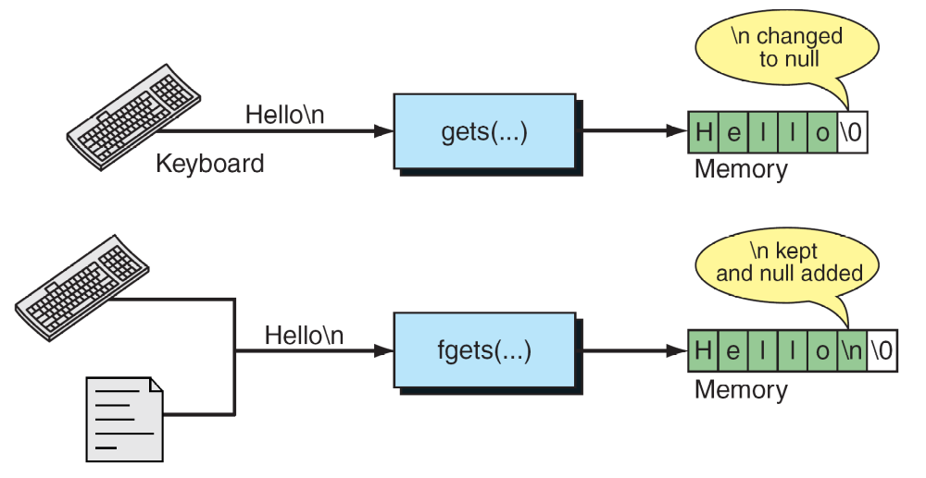
gets and fgets Functions

Slide 17
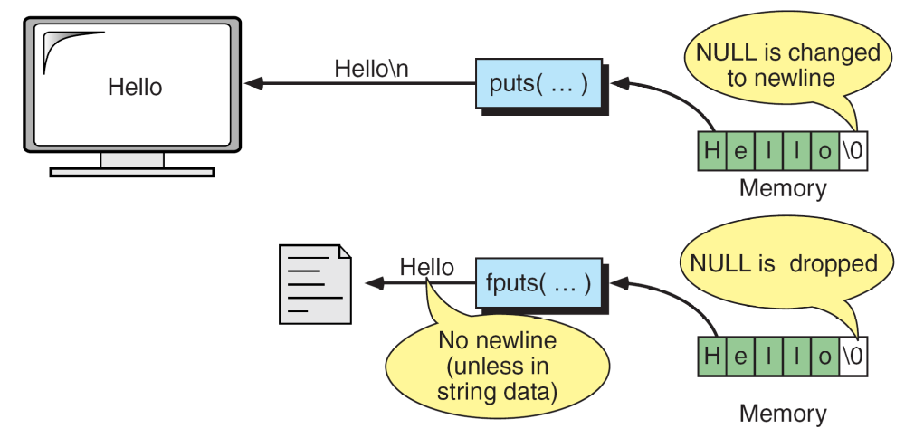
puts and fputs Operations

Slide 18
Arrays of Strings
Ragged arrays are very common with strings.
Consider, for example, the need to store the days of the week in their textual format.
We could create a two-dimensional array of seven days by ten characters, but this wastes space.

Slide 19
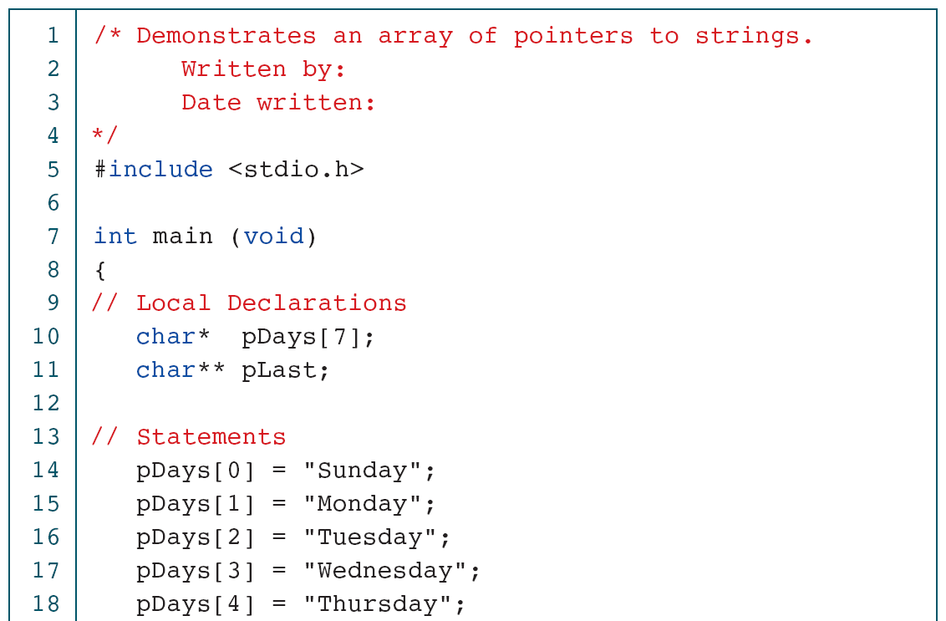
Print Days of the Week

Slide 20
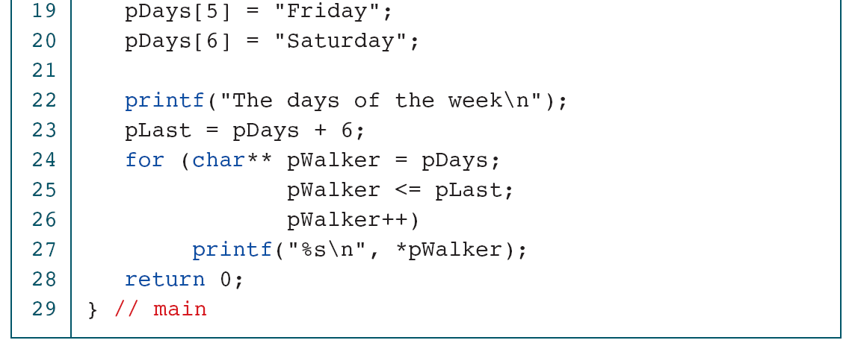
Print Days of the Week

Slide 21
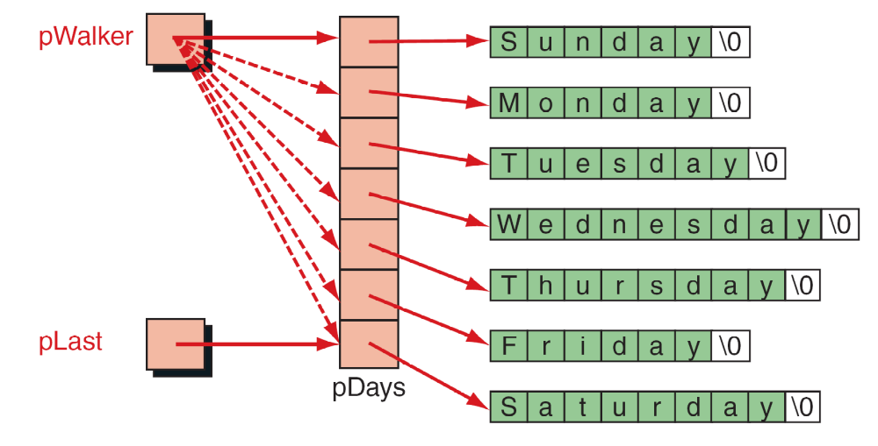
Pointers to Strings

Slide 22
Call by Value | Call by Reference
When Function is called the values of variables are passed. | When a function is called address of variables is passed.
Formal parameters contain the value of actual parameters. | Formal parameters contain the address of actual parameters.
Change of formal parameters in the function will not affect the actual parameters in the calling function | The actual parameters are changed since the formal parameters indirectly manipulate the actual parameters
Execution is slower since all the values have to be copied into formal parameters. | Execution is faster since only addresses are copied.

